Slide 1
The Basic Practice of Statistics Ninth Edition David S. Moore William I. Notz
Chapter 1
Picturing Distributions with Graphs
Lecture Slides
© 2021 W. H. Freeman and Company

Slide 2
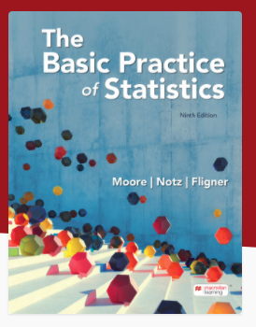

Slide 3
In Chapter 1 we cover …
Individuals and variables
Categorical variables: pie charts and bar graphs
Quantitative variables: histograms
Interpreting histograms
Quantitative variables: stemplots
Time plots

Slide 4
Data Science
Data science is a multidisciplinary field (Statistics, Computer Science, Mathematics) with the goals of extracting insight/information from data and making data-driven decisions.
Data Science encompasses: data collection, storage, preprocessing, analysis and visualisation.

Slide 5
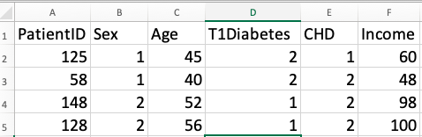
Statistics
Statistics is the science of data. The first step in dealing with data is to organize your thinking about the data.
Individual: an object described by a set of data
Variable: a characteristic of the individual
Individuals
Variables

Slide 6
When planning a study …
… or simply exploring data from someone else’s work, ask yourself these questions:
Who? | What individual does the data describe?
What? | How many and what are the exact definitions of the variables in the data? In what unit of measurement is each variable recorded?
Where? | The context of the data collection is always important.
When? | (see previous point.)
Why? | Were the data collected to describe just those individuals or to represent a larger group?

Slide 7
Types of Variables
A categorical variable places individuals into one of several groups or categories.
A quantitative variable takes numerical values for which arithmetic operations make sense (usually recorded in a unit of measurement).
Most data tables follow this format—the data here appear in a spreadsheet program.

Slide 8
Exploratory Data Analysis
An exploratory data analysis is the process of using statistical tools and ideas to examine data in order to describe their main features.
Exploring Data
Begin by examining each variable by itself. Then move on to studying the relationships among the variables.
Begin with a graph or graphs. Then add numerical summaries of specific aspects of the data.

Slide 9
Distribution of a Variable
To examine a single variable, we usually want to display its distribution.
Distribution of a variable
The distribution of a variable tells us what values it takes and how often it takes these values.
The values of a categorical variable are labels for the categories. The distribution of a categorical variable lists the categories and gives either the count or the percent of individuals who fall in each category.

Slide 10
Displaying Categorical Data
The distribution of a categorical variable lists the categories and gives either the count or the percent of individuals who fall into each category.
Pie charts show the distribution of a categorical variable as a “pie” where the sizes of the slices reflect the counts or percents for the categories.
Bar graphs represent each category as a bar whose height shows the category count or percent.

Slide 11
Pie Chart
EXAMPLE: What do the 1.5 million full-time first-year students plan to study? Here are data on the percents of post-secondary first-year students who plan to major in several discipline areas.
Field of Study | Percent of Student
Biological sciences | 15.5
Business | 13.8
Health professions | 11.7
Engineering | 11.5
Social sciences | 11
Arts and humanities | 8.8
Math and computer science | 6.2
Education | 4.4
Physical sciences | 2.7
Other majors and undeclared | 13.1
Total | 98.7
rounding error
Notes:
Note: book displays pie chart “slices” in alphabetical order of field of study, without any explanation of what is going on. Here, the categories in the pie chart are in the same order as those in the table, which is what statistical software typically does.

Slide 12
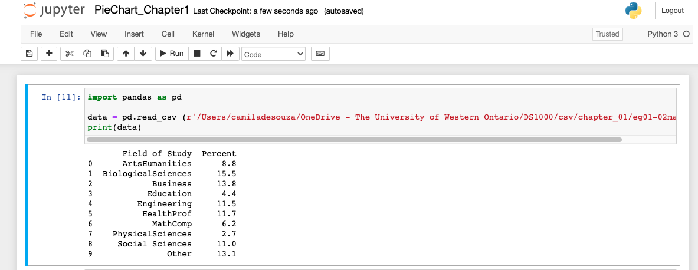
Lab tutorial – Jupyter Notebook
Notes:
Note: book displays pie chart “slices” in alphabetical order of field of study, without any explanation of what is going on. Here, the categories in the pie chart are in the same order as those in the table, which is what statistical software typically does.

Slide 13
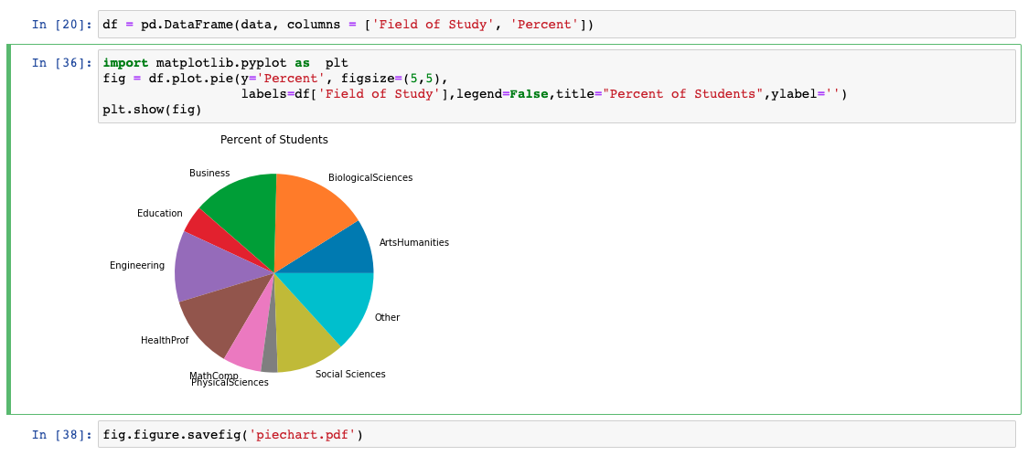
Lab tutorial – Jupyter Notebook
Notes:
Note: book displays pie chart “slices” in alphabetical order of field of study, without any explanation of what is going on. Here, the categories in the pie chart are in the same order as those in the table, which is what statistical software typically does.

Slide 14
Pie Charts or Bar Graphs
EXAMPLE (cont’d): Here are data on the percents of post-secondary first-year students who plan to major in several discipline areas, now alphabetized by field of study.
Field of Study | Percent of Student
Biological sciences | 15.5
Business | 13.8
Health professions | 11.7
Engineering | 11.5
Social sciences | 11
Arts and humanities | 8.8
Math and computer science | 6.2
Education | 4.4
Physical sciences | 2.7
Other majors and undeclared | 13.1

Slide 15
Bar Graphs Only
EXAMPLE: What sources do Americans aged 12–34 years use to keep up to date and learn about music?
Brand | Percent of 12-34s Who Have Listened to Each Brand
Pandora | 36
Spotify | 46
iHeartRadio | 14
Apple Music | 20
Amazon Music | 10
SoundCloud | 23
Google Play All Access | 8
Note: For bar graphs, percents don’t necessarily add to 100.

Slide 16
Quantitative Data
The distribution of a quantitative variable tells us what values the variable takes on and how often it takes on those values.
Histograms show the distribution of a quantitative variable by using bars where the height of each bar represents the number of individuals who take on a value within a particular class/interval.
Stemplots separate each observation into a stem and a leaf that are then plotted to display the distribution, while maintaining the original values of the variable.

Slide 17
Histograms (1 of 2)
Are appropriate for quantitative variables that take on many values and/or for large datasets.
Divide the possible values into classes/intervals (equal widths).
Count how many observations fall into each interval (may change to percents).
Draw a picture representing the distribution―bar heights are equivalent to the number (percent) of observations in each interval.

Slide 18
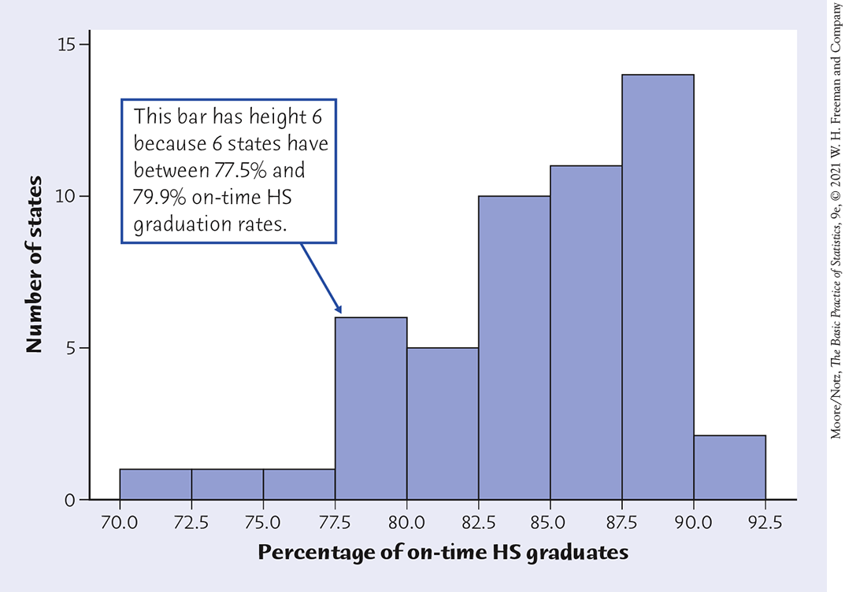
Histograms (2 of 2)
EXAMPLE: Freshman Graduation Rate, or FGR, Data for 2016–2017

Slide 19
Interpreting Histograms
EXAMINING A HISTOGRAM
In any graph of data, look for the overall pattern and for striking deviations from that pattern.
You can describe the overall pattern by its shape, center, and variability. You will sometimes see variability referred to as spread.
An important kind of deviation is an outlier, an individual that falls outside the overall pattern.

Slide 20
Overall Shape of Distributions
SYMMETRIC AND SKEWED DISTRIBUTIONS
A distribution is symmetric if the right and left sides of the graph are approximately mirror images of each other.
A distribution is skewed to the right (right-skewed) if the right side of the graph (containing the half of the observations with larger values) is much longer than the left side.
A distribution is skewed to the left (left-skewed) if the left side of the graph is much longer than the right side.
Symmetric
Right-skewed
Left-skewed

Slide 21
Stemplots (Stem-and-Leaf Plots) (1 of 2)
To make a stemplot:
Separate each observation into a stem (consisting of all but the final, or rightmost, digit) and a leaf (the final digit). Stems may have as many digits as needed, but each leaf contains only a single digit.
Write the stems in a vertical column with the smallest at the top, and draw a vertical line at the right of this column. Be sure to include all the stems needed to span the data, even when some stems have no leaves.
Write each leaf in the row to the right of its stem, in increasing order out from the stem.

Slide 22
Example of stemplot
5.3, 5.6, 5.3, 5.0, 5.5, 5.9, 5.9, 3.3, 5.0, 3.4, 5.0, 3.4, 4.6, 6.9, 6.0
Stems are the non-decimals, leaves are decimals and ordered

Slide 23
Example of stemplot
5.3, 5.6, 5.3, 5.0, 5.5, 5.9, 5.9, 3.3, 5.0, 3.4, 5.0, 3.4, 4.6, 6.9, 6.0
Stems are the non-decimals, leaves are decimals and ordered
3.3, 3.4, 3.4, 4.6, 5.0, 5.0, 5.0, 5.3, 5.3, 5.5, 5.6, 5.9, 5.9, 6.0, 6.9

Slide 24
Example of stemplot
5.3, 5.6, 5.3, 5.0, 5.5, 5.9, 5.9, 3.3, 5.0, 3.4, 5.0, 3.4, 4.6, 6.9, 6.0
Stems are the non-decimals, leaves are decimals and ordered
3.3, 3.4, 3.4, 4.6, 5.0, 5.0, 5.0, 5.3, 5.3, 5.5, 5.6, 5.9, 5.9, 6.0, 6.9
3 | 344
4 | 6
5 | 000335699
6 | 09

Slide 25
Stemplots (Stem-and-Leaf Plots) (2 of 2)
If there are very few stems (that is, when the data cover only a very small range of values), then we may want to create more stems by splitting the original stems.
EXAMPLE:
3.3, 3.4, 3.4, 4.6, 5.0, 5.0, 5.0, 5.3, 5.3, 5.5, 5.6, 5.9, 5.9, 6.0, 6.9
3 | 344 → decimals 0 to 4
3 | → decimals 5 to 9
4 |
4 | 6
5 | 00033
5 | 5699
6 | 0
6 | 9

Slide 26
Time Plots (1 of 3)
A time plot shows behavior over time.
Time is always on the horizontal axis, and the variable being measured is on the vertical axis.
Look for an overall pattern (trend) and for deviations from this trend. Connecting the data points by lines may emphasize this trend.
Look for patterns that repeat at known regular intervals (seasonal variations).

Slide 27
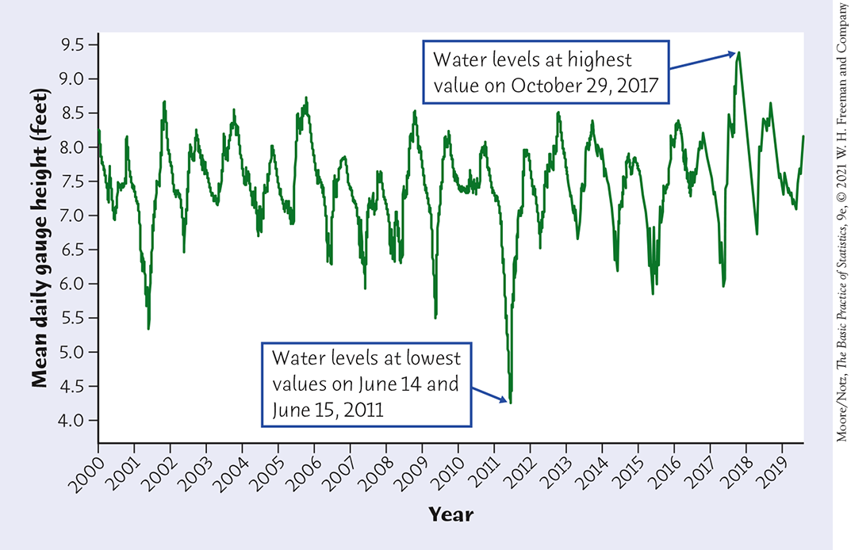
Time Plots (2 of 3)
Time Plot of Average Gauge Height,
Everglades National Park Monitoring Station

Slide 28
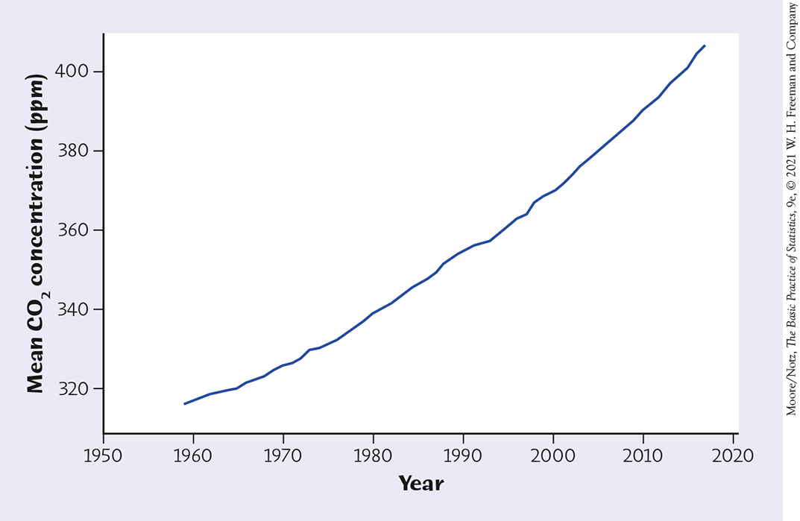
Time Plots (3 of 3)
Time Plot of the Mean Atmospheric CO₂ Concentration (ppm)

Slide 29
Florence Nightingale a pioneer on picturing data: Joy of Stats with Hans Rosling
https://www.youtube.com/watch?v=yhX0OR1_Vfc

